Slide 1

Pedro Mattiazzo Goudet
FORMER MARKETER AND FUTURE WEB DEVELOPER

Slide 2

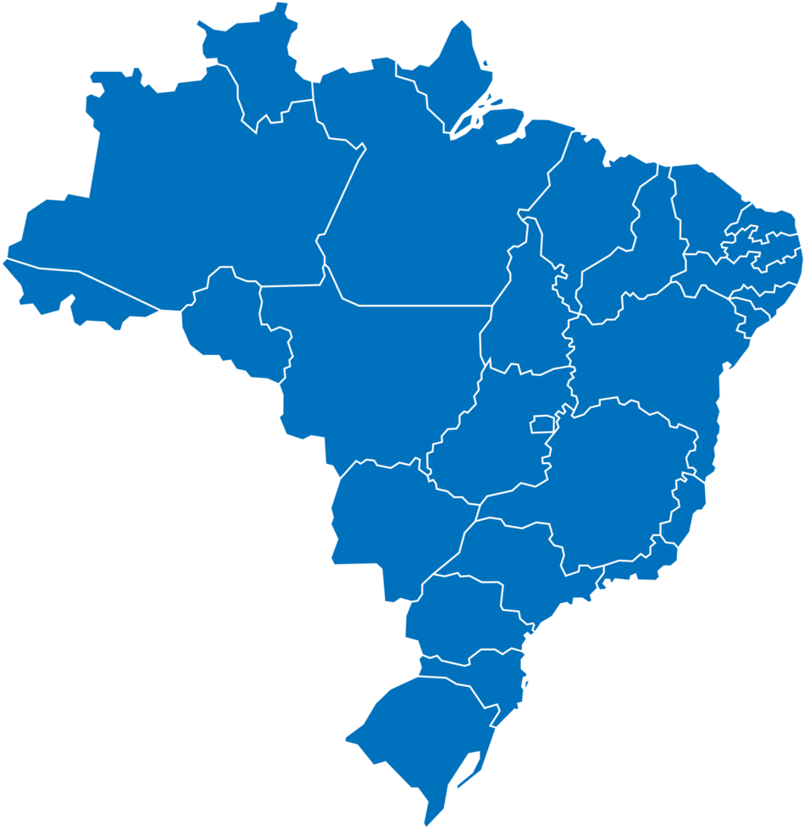

SP
Campinas

Slide 3
São Paulo
Campinas

Slide 4
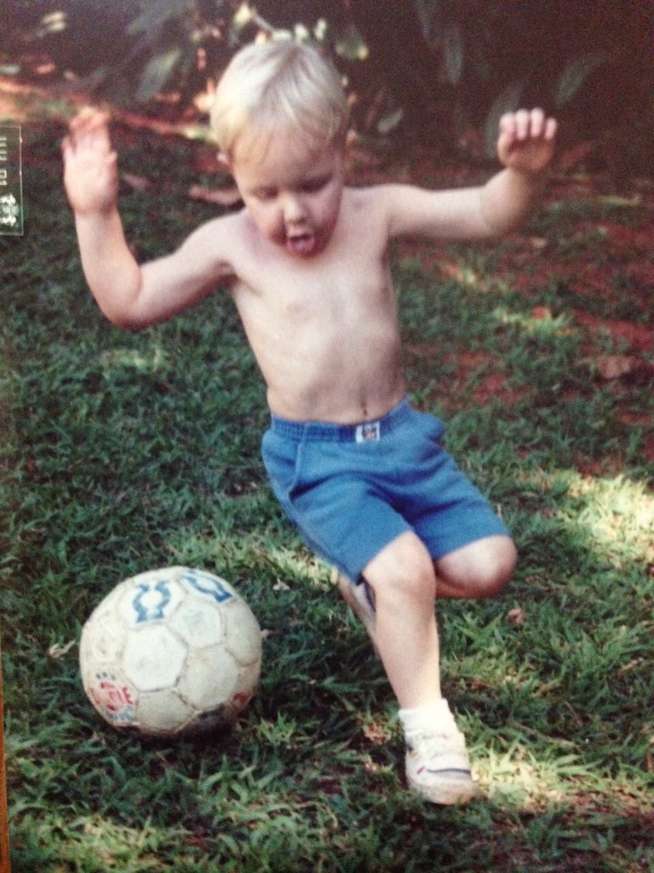

Slide 5
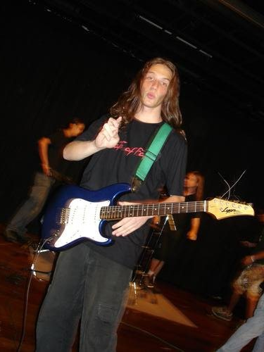

Slide 6
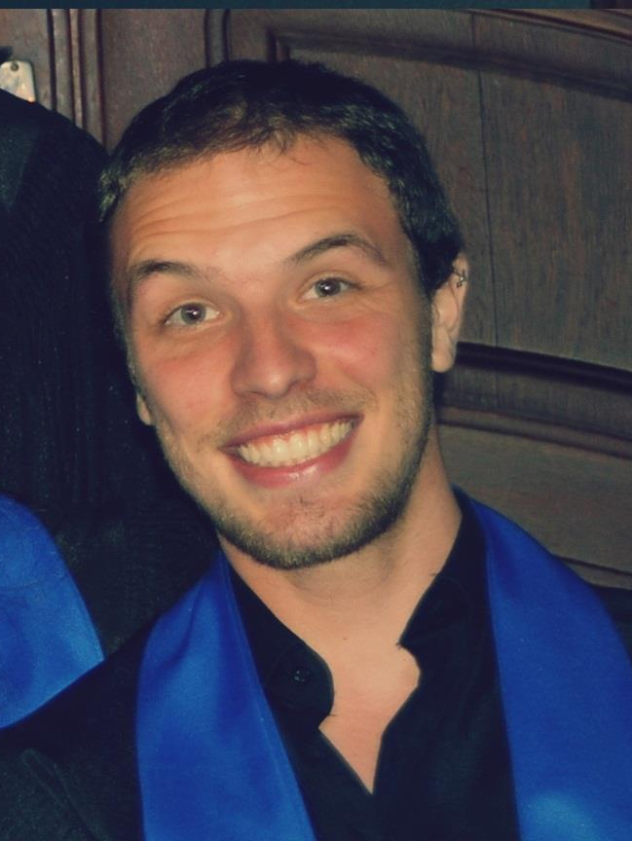

Slide 7
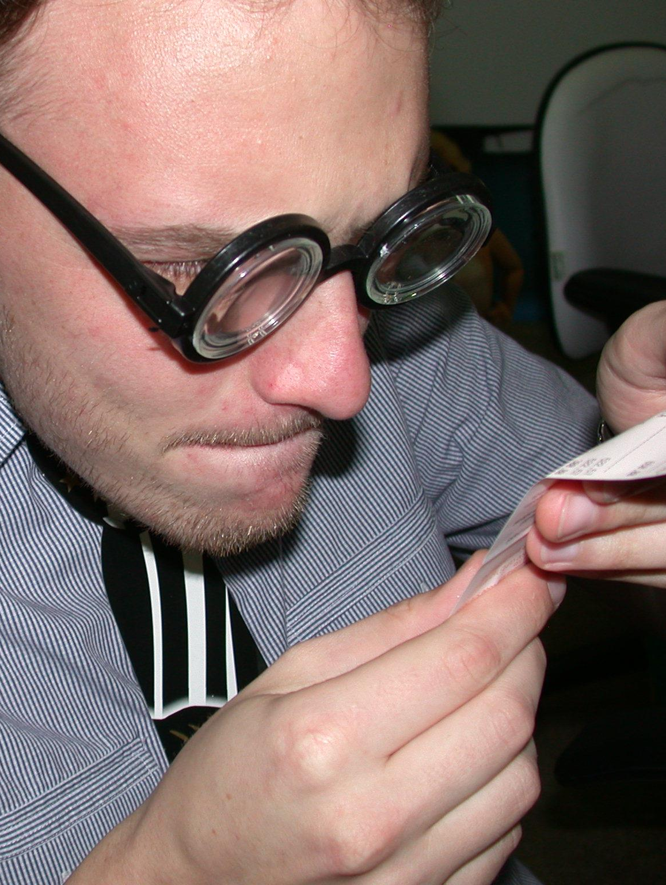

Slide 8


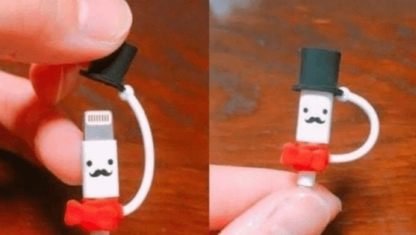
8 years of marketing

Slide 9

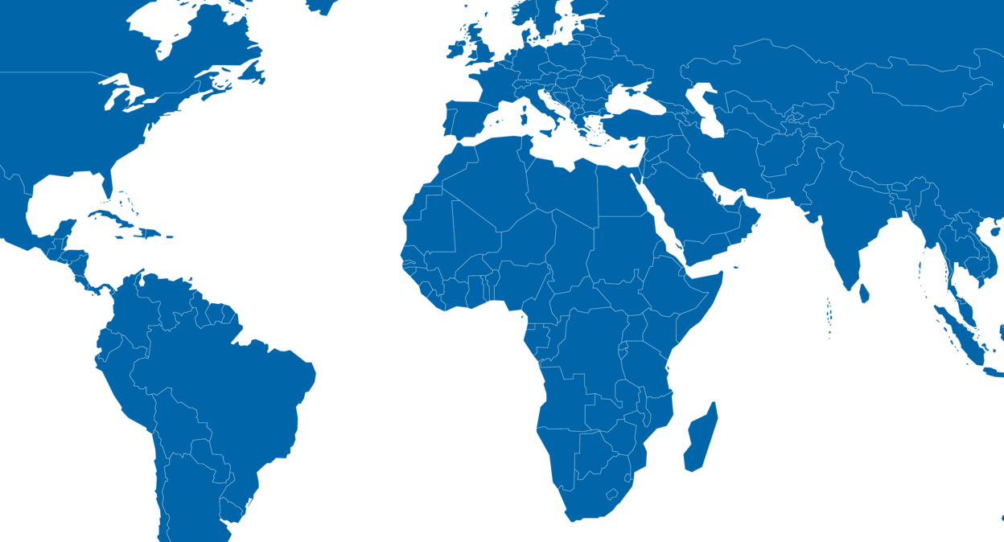

2017

Slide 10


2014
2024

Slide 11


2014
2024

Slide 12

2014
2024

Slide 13


Slide 14
Thank you!
Muito obrigado!

